Slide 1
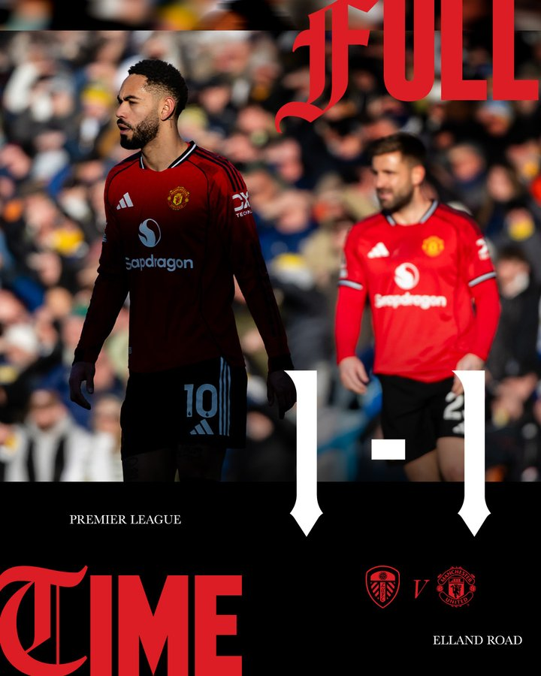
DIO RIZA PRATAMA
MAN UTD:
PERFORMANCE
ANALYSIS
LEEDS VS UNITED
04 JAN 26
@HTTPS://X.COM/MANUTD

Slide 2
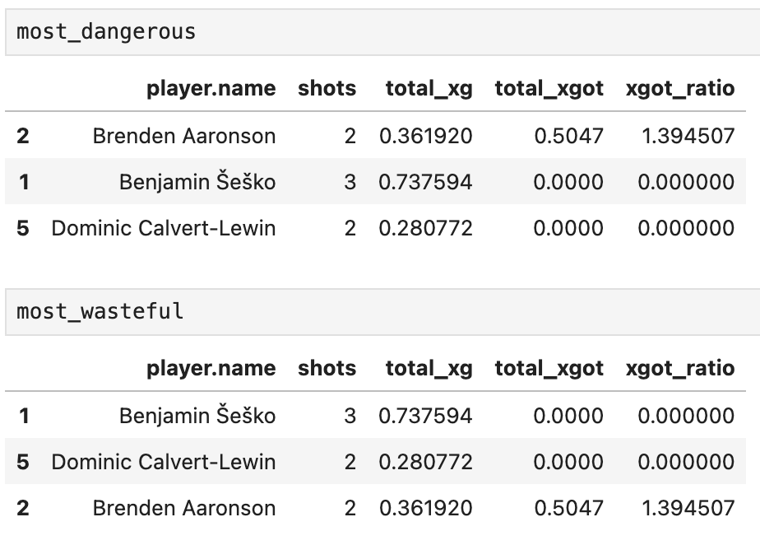
PLAYER REVIEW
MOST DANGEROUS VS MOST WASTEFUL

Slide 3
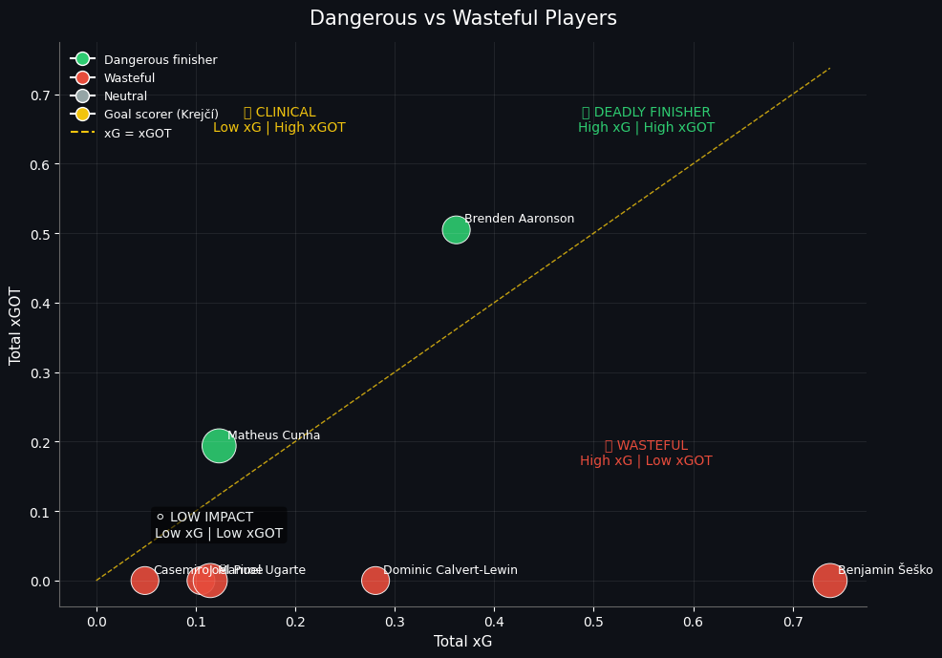
WHICH
PLAYERS OUTPERFORM THEIR
CHANCES?
FINISHING PERFORMANCE SCATTER
BRENDEN AARONSON STANDS OUT AS A DANGEROUS FINISHER (HIGH XG & HIGH XGOT). HE GETS GOOD CHANCES AND HITS THE TARGET WELL.
MATHEUS CUNHA ALSO SHOWS AS A DANGEROUS FINISHER BUT WITH LOWER XG — EFFICIENT WITH LIMITED CHANCES.
BENJAMIN ŠEŠKO AND DOMINIC CALVERT-LEWIN APPEAR WASTEFUL (HIGH XG BUT LOW XGOT), MEANING THEY GET CHANCES BUT FAIL TO CONVERT THEM INTO QUALITY SHOTS ON TARGET.
CASEMIRO, JOÃO PALHINHA, AND MANUEL UGARTE FALL INTO LOW-IMPACT TERRITORY (LOW XG & LOW XGOT), MEANING THEY NEITHER CREATE NOR FINISH SHOOTING OPPORTUNITIES.

Slide 4
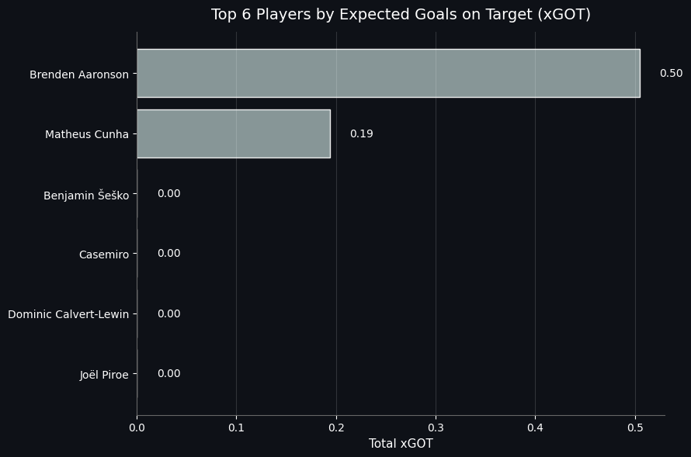
TOP SIX PLAYERS BY EXPECTED GOALS
FINISHING PERFORMANCE DIAGRAM

Slide 5
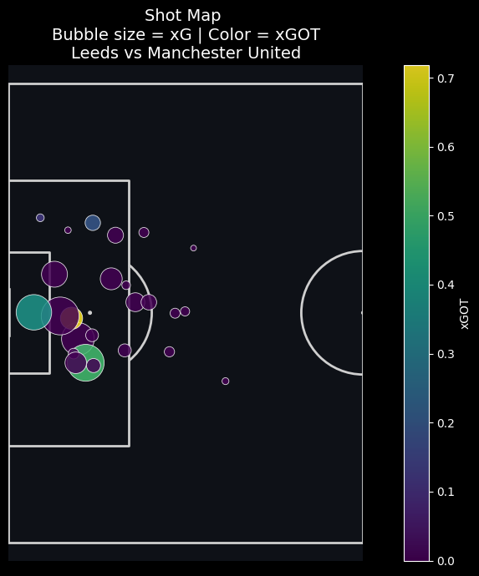
UNITED GAMEPLAY
OPEN PLAY:
11 SHOTS ~ XG 1.03
OPEN PLAY VS SET-PIECE
SET-PIECE:
4 SHOTS ~ XG 0.4
DESPITE A RELATIVELY HIGH SHOT VOLUME, UNITED’S CHANCE QUALITY REMAINED LOW, HIGHLIGHTING INEFFICIENCIES IN BOTH OPEN PLAY AND SET-PIECE EXECUTION.

Slide 6
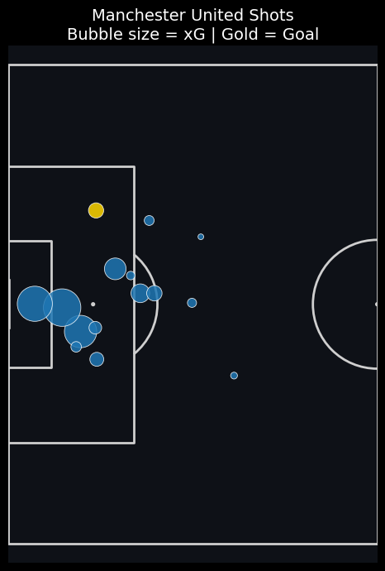
SHOTMAP
AREA

Slide 7
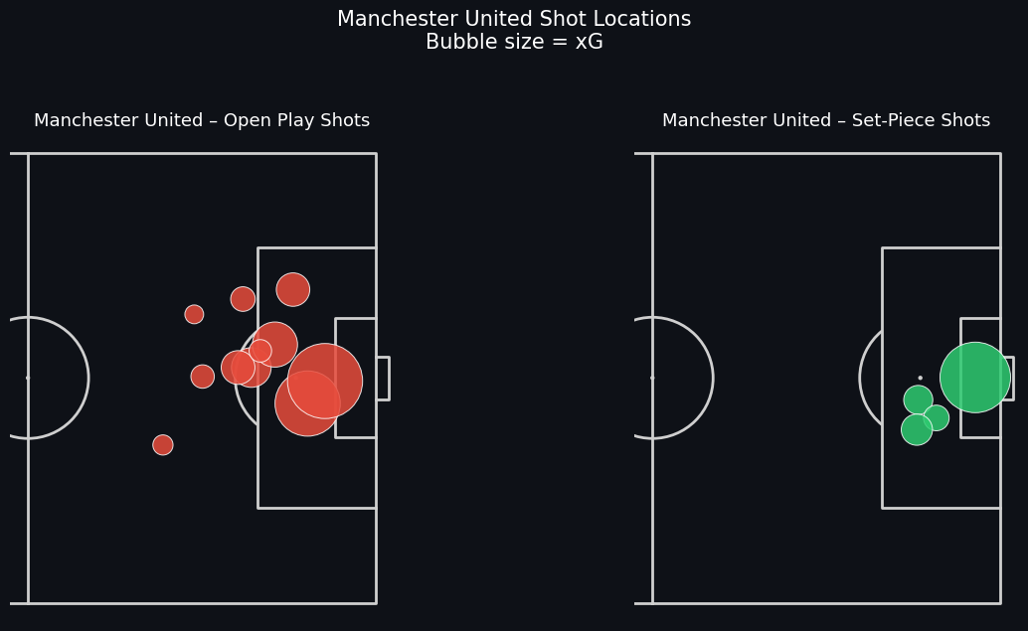
OPEN PLAY VS SET-PIECE

Slide 8
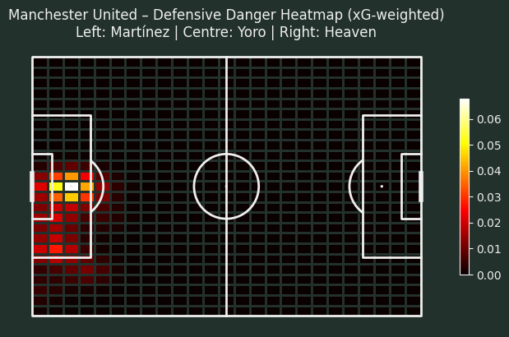
DEFENSIVE DANGER AREA

Slide 9
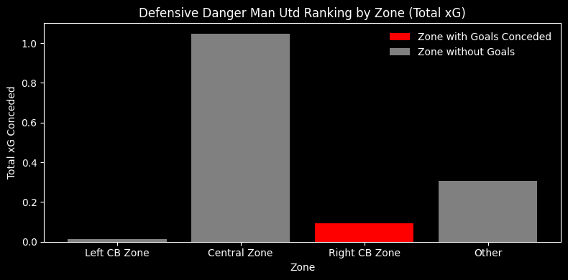
DEFENSIVE DANGER AREA

Slide 10
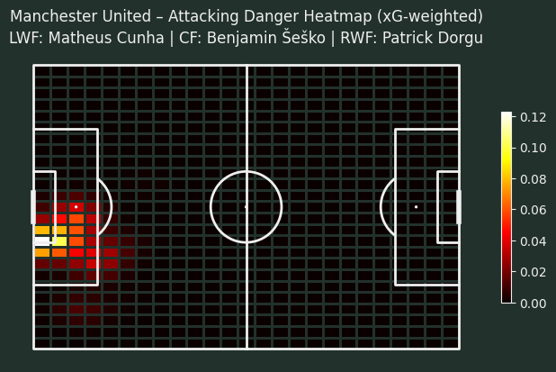
ATTACKING DANGER AREA

Slide 11
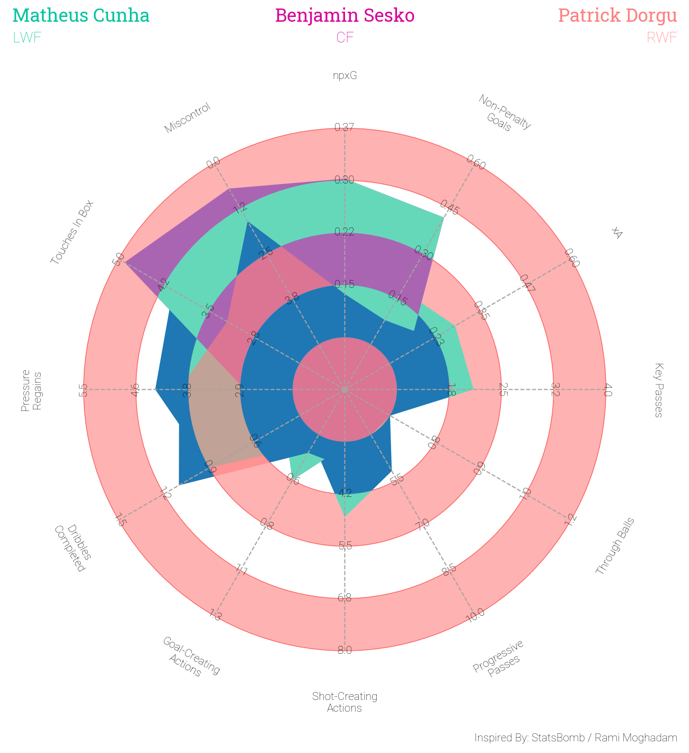
TRIO ATTACKERS
PERFORMANCE

Slide 12
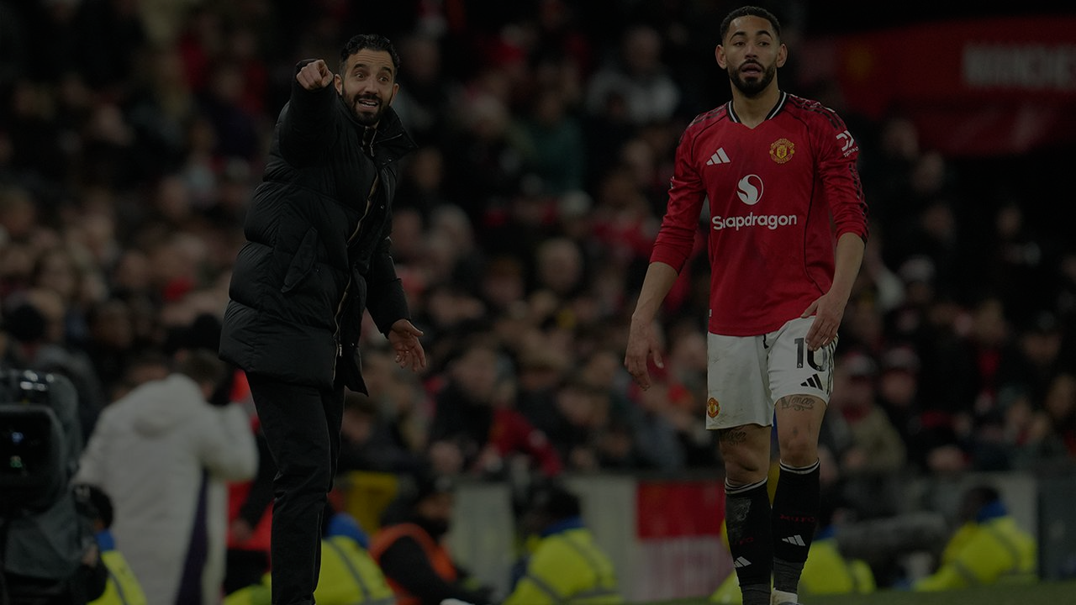
CONCLUSION
UNITED ISSUES:
OPEN PLAY RELIES TOO MUCH ON SPECULATIVE SHOTS
TEMPO SWITCHES TOO SLOW IN BUILD-UP
POOR SHOT SELECTION IN FINAL THIRD
LACK OF CUTBACKS & 2ND-LINE RUNNERS
POTENTIAL TO BE MAXIMIZED
SET-PIECE ROUTINES & DELIVERY
TRANSITIONS AFTER WINNING POSSESSION
AERIAL THREAT INSIDE THE BOX
DATA-BASED RECOMMENDATIONS
REDUCE
CROSSES WITHOUT CLEAR TARGET
LONG SHOTS UNDER PRESSURE
INCREASE
CUTBACKS FROM HALF-SPACE

Slide 13
